Slide 1


DESIGN PATTERNS
CHINA
MARCH 11, 2015

Slide 2
AGENDA
1
Why Patterns matter
2
Singleton
3
Factory Method
4
Static Factory Method
5
Strategy
6
Decorator
7
Composite

Slide 3
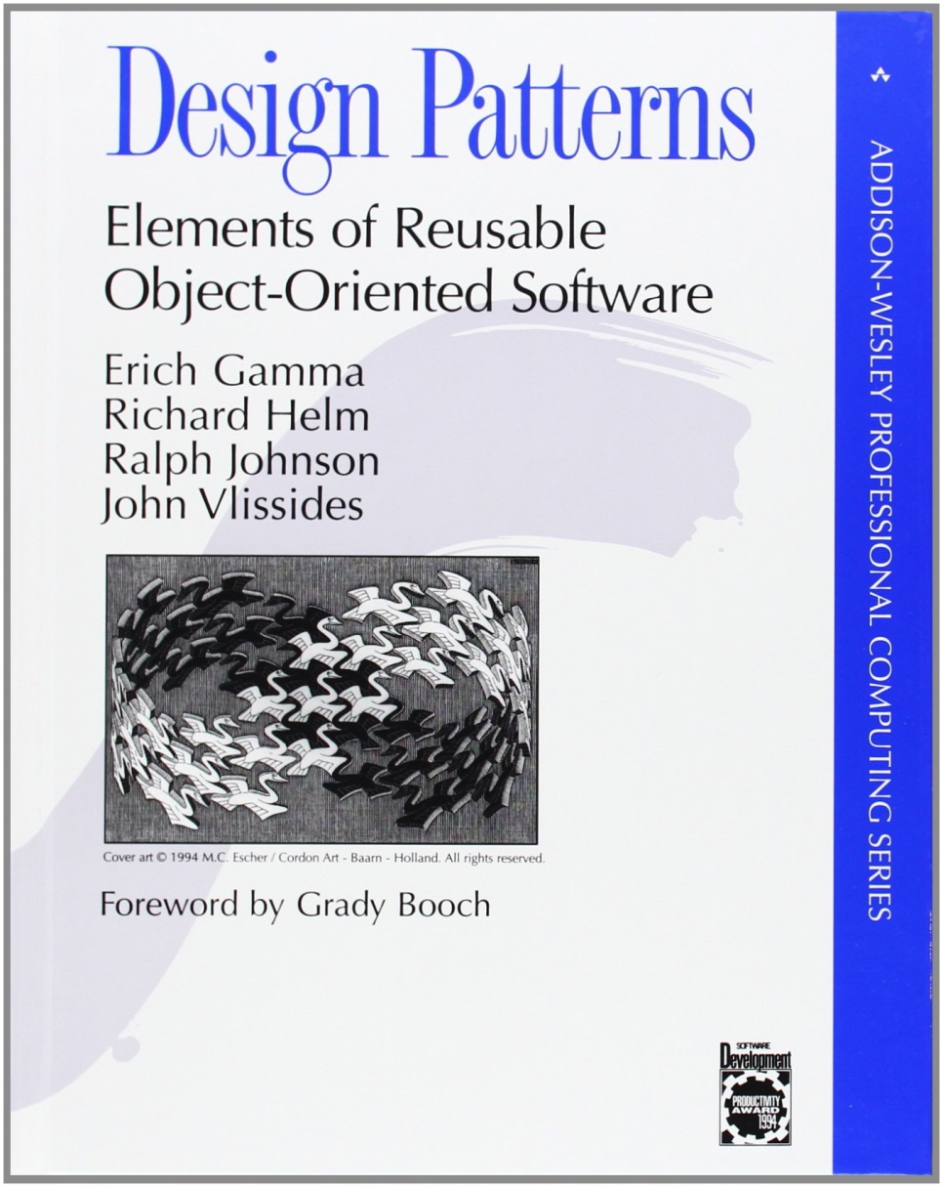
WHY PATTERNS MATTER

Slide 4
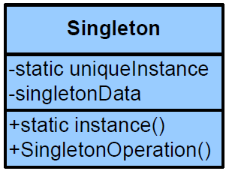
SINGLETON
Goal
Guarantee that class has only one instance
Using
Use it when you want to have only one instance of the class, independently of invocation point in client code

Slide 5
STATIC FACTORY METHOD
Goal
Quick and easy way of creating objects without creating additional classes and more convenient than just Constructor
Using
Use it when you want to provide a meaningful name for constructor
When you want to provide several constructors with the same amount and type of parameters.

Slide 6
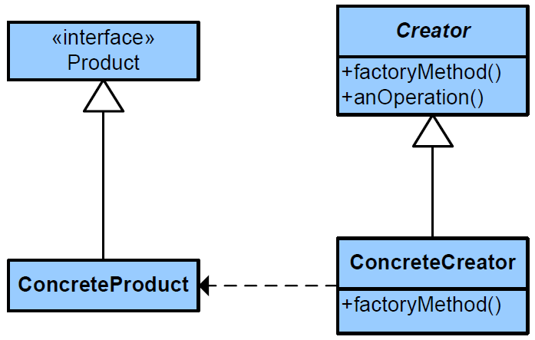
FACTORY METHOD
Goal
Define an interface for creating an object, but let the classes that implement the interface decide which class to instantiate.
The Factory method lets a class defer instantiation to subclasses
Using
Class doesn’t know the type of the object it is supposed to create
Class doesn’t depend on concrete realization
Created subclass requires additional configuration, it is inconvenient to use constructor

Slide 7
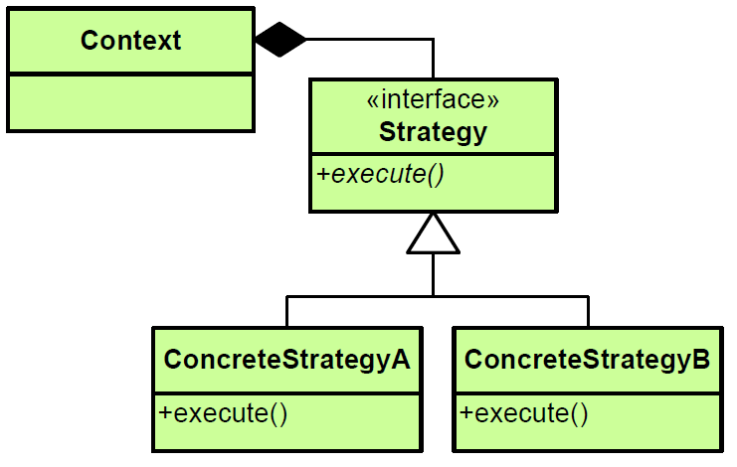
STRATEGY
Goal
An algorithm's behavior can be selected at runtime.
Strategy pattern defines a family of algorithms, encapsulates each one, and makes them interchangeable
Using
Use it when program should provide different types of algorithms or behaviors, encapsulated from client code
When it is necessary to change the behavior at runtime

Slide 8
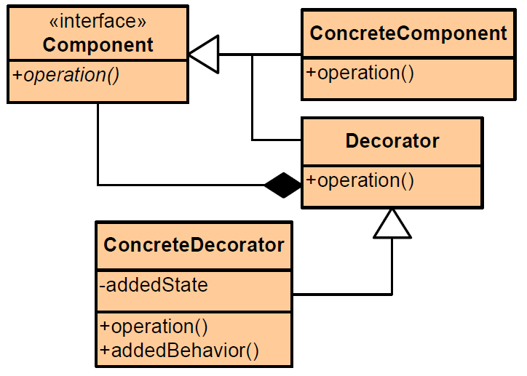
DECORATOR
Goal
Allows behavior to be added to an individual object dynamically. Functionality can be performed before, after or even instead of the main functionality.
It’s flexible alternative for creating subclasses approach
Using
Use it when you want to add some functionality only to some objects of the class, not to all
When it’s difficult or impossible to inherit the class

Slide 9
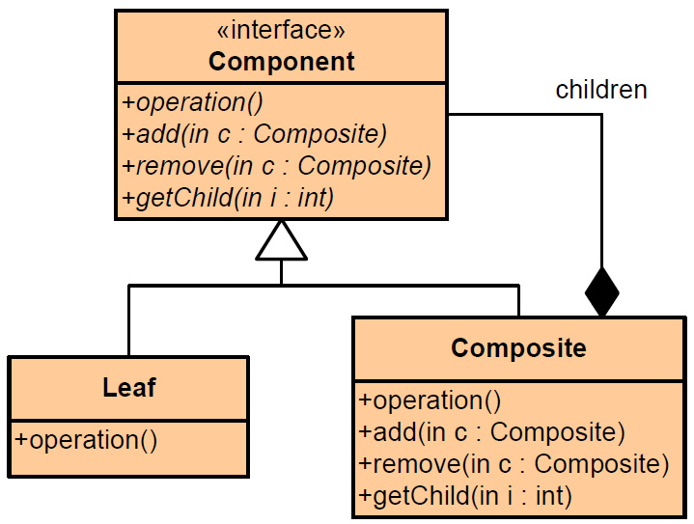
COMPOSITE
Goal
The composite pattern describes that a group of objects are to be treated in the same way as a single instance of an object.
Composite pattern lets clients treat individual objects and compositions uniformly
Using
Use it when clients should ignore the difference between compositions of objects and individual objects
When you want to operate the group of the same objects by one interface, not by interacting with each object

